Slide 1
The Nature of Software and Software Engineering
COMP6100001 - Software engineering
Session 01
Kenny Jingga, S.Kom., M.T.

Slide 2
Session 01 – The Nature of Software and Software Engineering
Learning objectives
At the end of this session, students will be expected to be able to:
Understand the Definition and Importance of Software Engineering
Explain Key Characteristics of Software and the Challenges They Present
Identify Core Trade-offs and Costs in Software Development
Explore the Role of Software Engineers in Industry

Slide 3
Session 01 – The Nature of Software and Software Engineering
Content outline
Definition of Software and Software Engineering
Importance of Software in Modern Society
Characteristics of Software Systems
Time and Change
Scale and Efficiency
Trade-offs and Costs
The Software Engineering Profession

Slide 4
Software is everywhere

Slide 5
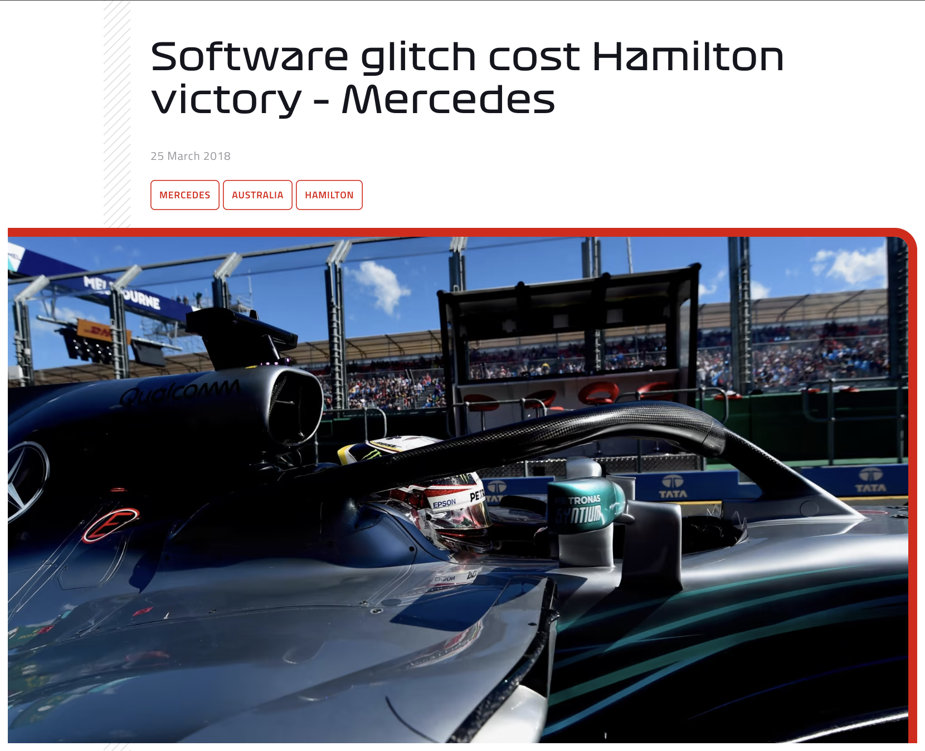
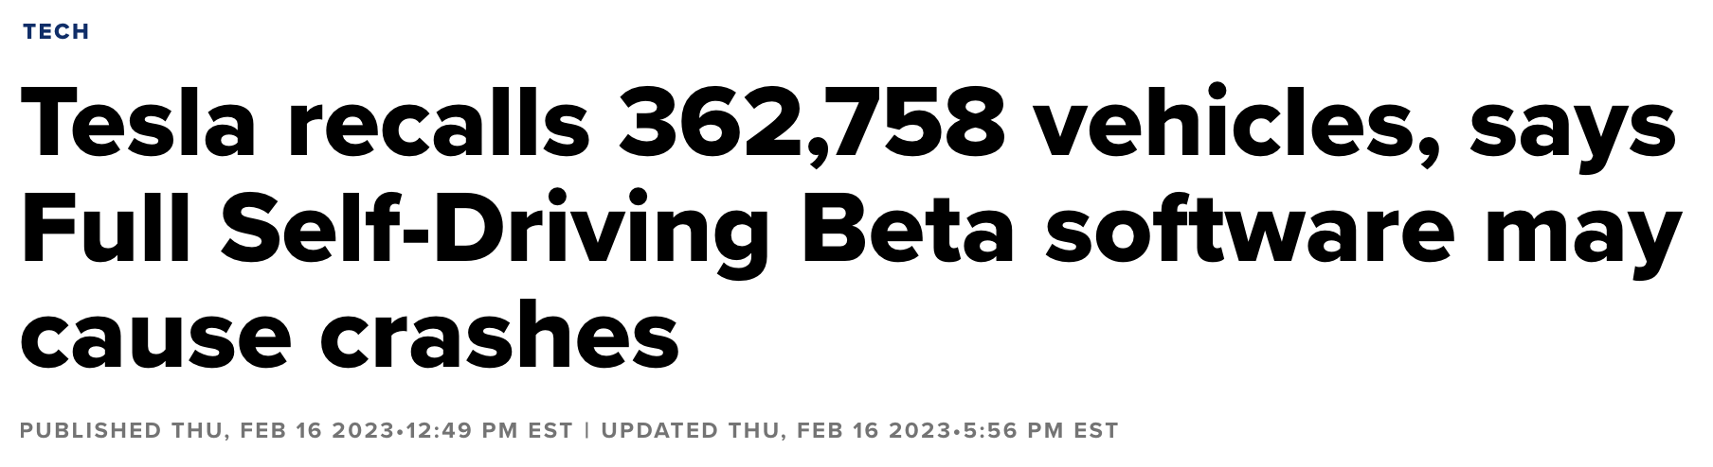

Software is Everywhere
Issues in Software or system
https://www.cnbc.com/2023/02/16/tesla-recalls-362758-vehicles-says-full-self-driving-beta-software-may-cause-crashes.html
https://www.formula1.com/en/latest/article.software-glitch-cost-hamilton-victory-mercedes.6VzyCYpEpauaIYsOWYCqYS.html
https://www.thejakartapost.com/indonesia/2023/07/06/hacker-breaches-data-of-34-million-indonesian-passports.html

Slide 6


Software is Everywhere
Issues in Software or system
https://www.seattletimes.com/business/boeing-aerospace/failed-certification-faa-missed-safety-issues-in-the-737-max-system-implicated-in-the-lion-air-crash/
https://www.theverge.com/2019/5/2/18518176/boeing-737-max-crash-problems-human-error-mcas-faa

Slide 7
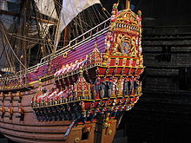
Vasa Syndrome
Story of Vasa
Vasa, 17th-century vessel, the mightiest warship of its day, that sank on its maiden voyage, on 10th August 1628 in Baltic Sea
While the Thirty Years’ War was raging in Europe, King Gustavus Adolphus of Sweden realized he needed a stronger naval presence if he were to retain his dominance in the Baltic.
He ordered five heavy-duty warships to be built. The Vasa, with two gun-decks, 64 bronze cannons, and a 450-man crew, was to be a mighty vessel; each broadside was capable of hurling some 250 kg (550 lb) of shot, which was twice as much as the most powerful European ships of her day.
But the project became fraught with problems: the King was pressing for quick delivery, yet he kept interfering with the plans, endlessly fiddling with measurements and demanding constant modifications; a shortage of money mid-project led to more delays; and to cap it all the head shipwright suddenly dropped dead.

Slide 8

Vasa Syndrome
Story of Vasa
At long last the Vasa was ready for her maiden voyage. It was a calm day with a light breeze—perfect sailing weather. The gun ports were opened ready to fire a salute.
After sailing only 1,130 m (3,700 ft) the sail suddenly billowed and the Vasa heeled violently to port. She immediately righted herself, but at the next gust she leant even further and disaster struck—water poured into the open gun ports.
The inrush made her heel so far that she collapsed on her side. The pride of the Swedish fleet met her ignominious end a mere 120 m (393 ft) from land in full view of a crowd of thousands.
Gustavus Adolphus was incandescent with rage. The ship’s captain was immediately arrested while the shipbuilders and the crew blamed each other. It soon became clear that it was the actual construction at fault. There was nobody to blame: the original contractor was dead, and the King himself had personally overseen every measurement. Everyone else had just obeyed orders.

Slide 9
Vasa Syndrome
What happened is now called “vasa Syndrome”
Changing shipbuilding orders
No specifications for modified keel
Shifting armaments requirements
Shipwright’s death
No way to calculate stability, stiffness, or sailing characteristics
Failed pre-launch stability tests

Slide 10
Vasa Syndrome
What happened is now called “vasa Syndrome”
Changing shipbuilding orders
No specifications for modified keel
Shifting armaments requirements
Shipwright’s death
No way to calculate stability, stiffness, or sailing characteristics
Failed pre-launch stability tests
Requirements
Teams
Metrics
QA

Slide 11
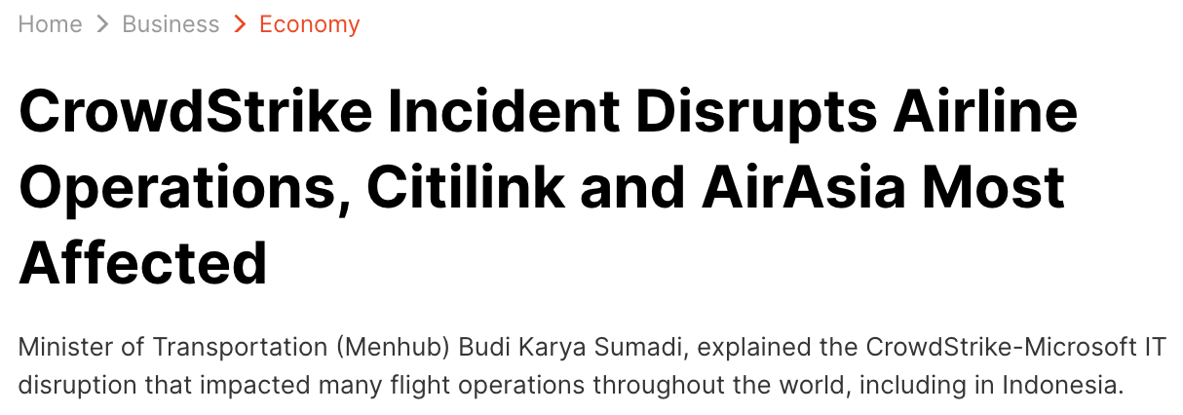
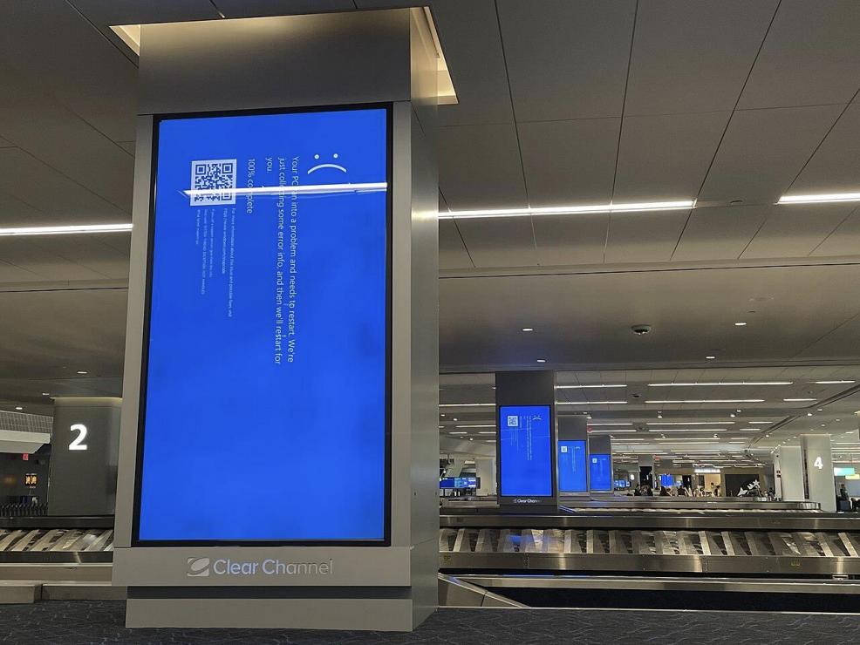
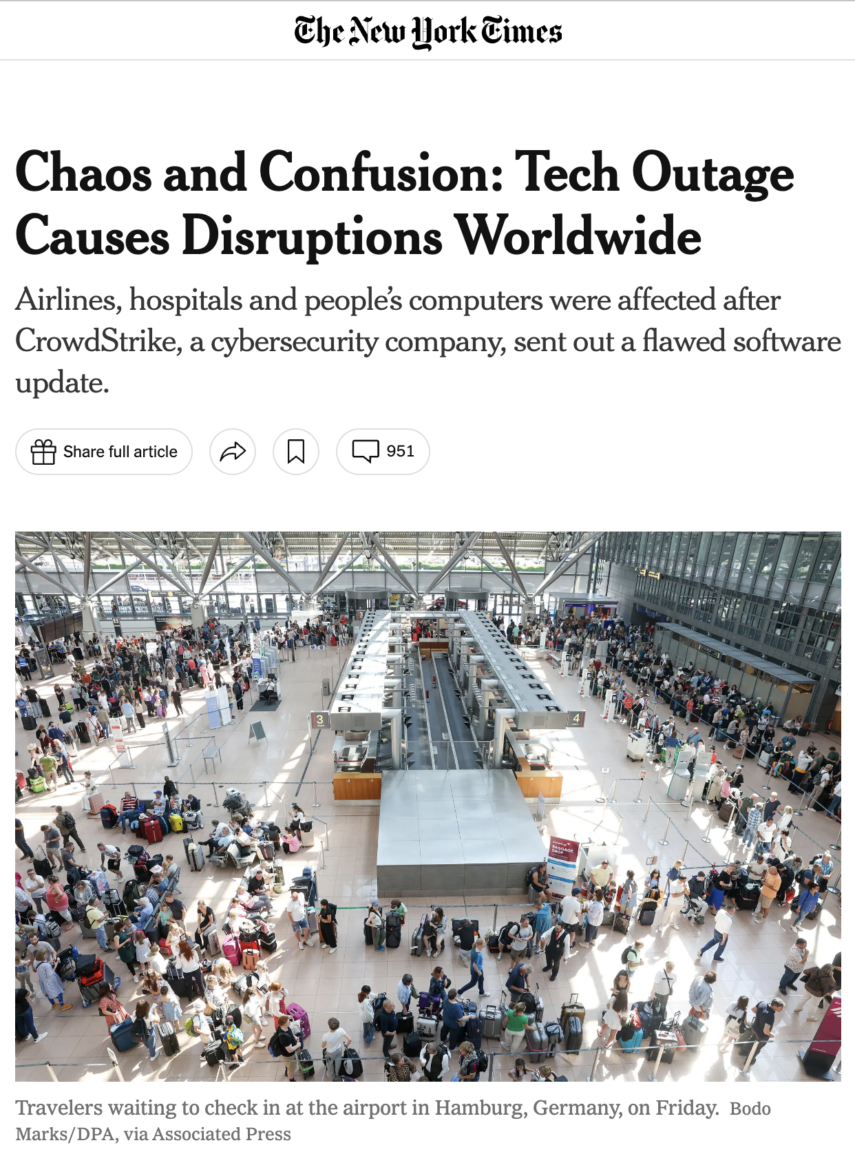
The Crowdstrike incident
Latest issue in software (2024)
https://www.liputan6.com/bisnis/read/5649816/insiden-crowdstrike-ganggu-operasional-maskapai-citilink-dan-airasia-paling-terdampak?page=2
https://www.nytimes.com/2024/07/19/business/microsoft-outage-cause-azure-crowdstrike.html
LaGuardia Airport, New York City
Photo by Smishra1 - Own work, CC BY-SA 4.0, https://commons.wikimedia.org/w/index.php?curid=150535443

Slide 12
The Crowdstrike incident
Complex Software Engineering issues involved
Software running with kernel-level privilege can crash the system (BSOD) and prevent booting
Content updates more continuous than software updates
Insufficient testing of content *and* parser
No staged roll-outs
No way to fix issue remotely after impact
Skewed incentives
Limited liability
Requirements
(Architecture & Design)
QA
DevOps
Metrics
Licenses

Slide 13
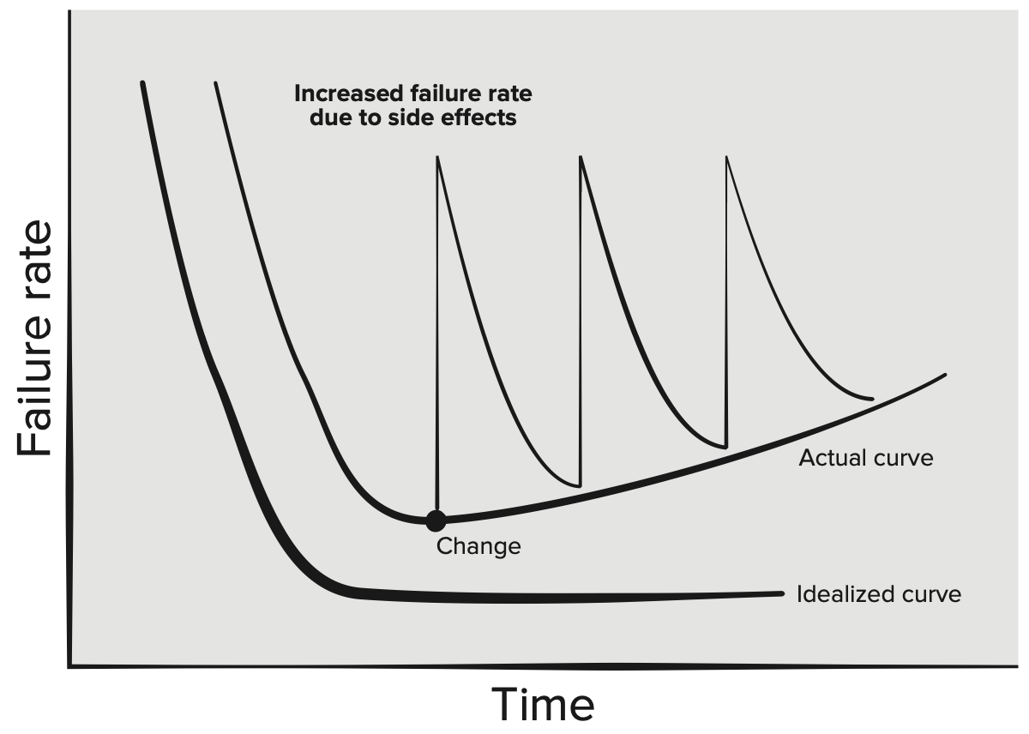
What is Software Engineering?
What is Software?
Software is:
Instructions (computer programs) that when executed provide desired features, function, and performance;
Data structures that enable the programs to adequately manipulate information; and
Descriptive information in both hard copy and virtual forms that describes the operation and use of the programs.
Unlike hardware, software doesn’t wear out. It deteriorates instead!

Slide 14
What is Software Engineering?
Software Application Domains
System software. A collection of programs written to service other programs.
Application software. Stand-alone programs that solve a specific business need.
Engineering/scientific software. A broad array of “number-crunching” or data science programs that range from astronomy to volcanology, from automotive stress analysis to orbital dynamics, from computer-aided design to consumer spending habits, and from genetic analysis to meteorology.
Embedded software. Resides within a product or system and is used to implement and control features and functions for the end user and for the system itself.
Product-line software. Composed of reusable components and designed to provide specific capabilities for use by many different customers.
Web/mobile applications. This network-centric software category spans a wide array of applications and encompasses browser-based apps, cloud computing, service-based computing, and software that resides on mobile devices.
Artificial intelligence software. Applications within this area include robotics, decision-making systems, pattern recognition (image and voice), machine learning, theorem proving, and game playing.

Slide 15
What is Software Engineering?
Software Engineering vs Programming
“Software engineering is programming integrated over time”
Programming tasks focus only on development
Software engineering tasks focus on development, modification, maintenance
The difference stems from the management of code over time, the impact of time on scale, and decision making in the face of those ideas
Programming is the immediate act of producing code
Software engineering is the set of policies, practices, and tools that are necessary to make that code useful for as long as it needs to be used and allowing collaboration across a team

Slide 16
What is Software Engineering?
Definition of Software Engineering
The IEEE definition:
The application of a systematic, disciplined, quantifiable approach to the development, operation, and maintenance of software; that is, the application of engineering to software.

Slide 17

What is Software Engineering?
Software Engineering Layers
Software engineering is a layered technology and rests on an organizational commitment to quality
The foundation for software engineering is the process layer, process defines a framework that must be established for effective delivery of software engineering technology
Software engineering methods provide the technical how-to’s for building software, which encompass a broad array of tasks that include communication, requirements analysis, design modeling, program construction, testing, and support
Software engineering tools provide automated or semi-automated support for the process and the methods
Tools integrated, computer-aided software engineering is established

Slide 18
Time And Change
Time
Successful projects have an effectively unbounded life span
Example: It is impossible to reasonably predict an endpoint for Google Search, the Linux kernel, or the Apache HTTP Server project
In developing projects → assume that projects will live indefinitely—we cannot predict when we won’t need to upgrade our dependencies, language versions, and so on
As their lifetimes grow, these long-lived projects eventually have a different feel to them than programming assignments or start-up development

Slide 19
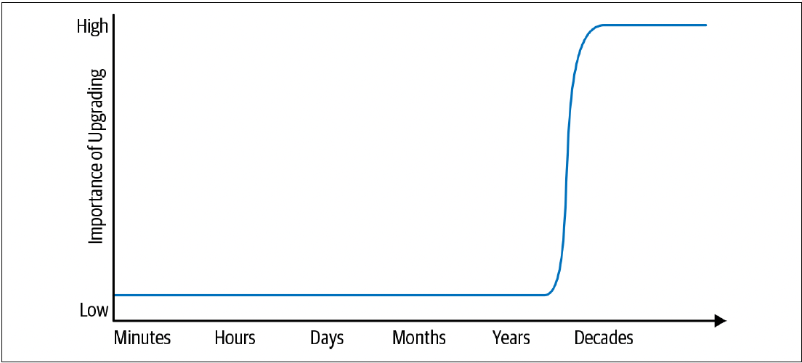
Time And Change
Lifespan and importance of upgrade
The low and high points on the expected life span spectrum suggest that there’s a transition somewhere
Somewhere along the line between a one-off program and a project that lasts for decades, a transition happens: a project must begin to react to changing externalities

Slide 20
Time And Change
Project Sustainability
Reliably stay current going forward → essence of long-term sustainability for your project
Sustainability requires planning and managing the impact of required change
Achieve sustainability, largely through trial and error
Concretely, how does short-term programming differ from producing code with a much longer expected life span?
Need to be much more aware of the difference between “happens to work” and “is maintainable.”
There is no perfect solution for identifying these issues
Keeping software maintainable for the long-term is a constant battle

Slide 21
Time And Change
Hyrum’s Law
“With a sufficient number of users of an API, it does not matter what you promise in the contract: all observable behaviours of your system will be depended on by somebody.”
“it works” vs “it is maintainable”, which to choose?
Discussions of change and maintenance over time must be aware of Hyrum’s Law
Depends crucially on the expected life span of the code in question

Slide 22
Time And Change
Why Not Just Aim for “Nothing Changes”?
For most projects, over a long enough time period, everything underneath them might need to be changed
Most projects have far more exposure to shifting underlying technology
Efficiency concerns are particularly subtle: the original design might have been perfectly logical and following reasonable best practices
It’s only after an evolution of backward-compatible changes that a new, more efficient option becomes important.
No mistakes were made, but the passage of time still made change valuable.

Slide 23
Scale and Efficiency
Scale
If changing something comes at inordinate cost, it will likely be deferred
If costs grow super linearly over time, the operation clearly is not scalable
Eventually, time will take hold and something unexpected will arise that you absolutely must change
Everything your organization relies upon to produce and maintain code should be scalable in terms of overall cost and resource consumption. Example: human costs, traditional resources, the development of that software, codebase.
In particular, everything your organization must do repeatedly should be scalable in terms of human effort

Slide 24
Scale and Efficiency
Factors that Affect the Flexibility of a Codebase
Expertise
Know how to do. Example: Have done hundreds of compiler upgrades across many platforms
Stability
Less change between releases by adopting releases more regularly
Conformity
Less code that hasn’t been through an upgrade already
Familiarity
Because of the regularity, redundancies can be spotted easily in the process of performing an upgrade and attempt to automate
Policy
The net effect of these processes is that upgrades remain feasible because infrastructure teams do not need to worry about every unknown usage, only the ones that are visible in our CI systems.

Slide 25
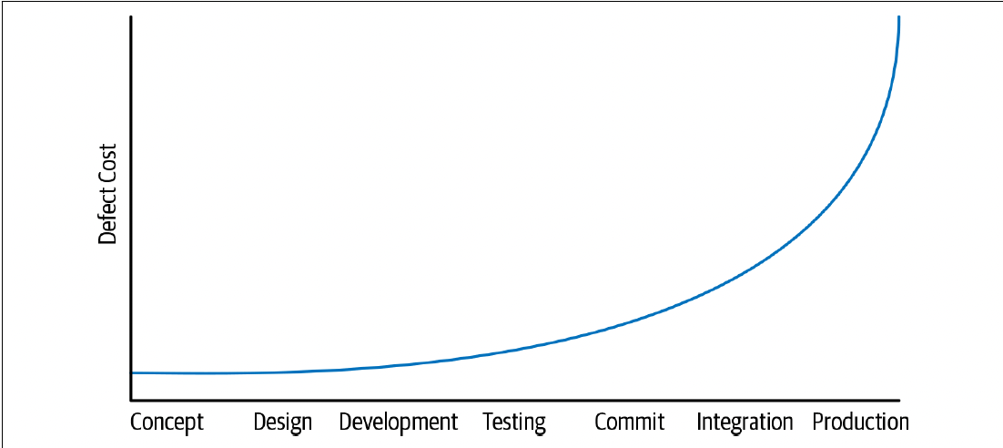
Scale and Efficiency
Shifting left
Shifting problem detection to the “left” earlier on this timeline makes it cheaper to fix than waiting longer

Slide 26
Trade-offs and costs
Trade-offs
Understand how to program, understand the lifetime of the maintained software, and understand how to maintain as scaling up with more engineers producing and maintaining new features
All that is left is to make good decisions
Decisions → impact costs
Cost → effort and can involve any or all of these factors:
Financial costs → money
Resource costs → CPU time
Personnel costs → engineering effort
Transaction costs → what does it cost to take action?
Opportunity costs → what does it cost to not take action?
Societal costs → what impact will this choice have on society at large?

Slide 27
Trade-offs and costs
Decision making
Decisions in an engineering group should come down to very few things:
We are doing this because we must (legal requirements, customer requirements).
We are doing this because it is the best option (as determined by some appropriate decider) we can see at the time, based on current evidence.
Decisions should not be “We are doing this because I said so.”

Slide 28
Trade-offs and costs
Inputs to Decision making
Based on data → two common scenarios:
All of the quantities involved are measurable or can at least be estimated. Example: evaluating trade-offs between CPU and network, or dollars and RAM, or considering whether to spend two weeks of engineer-time in order to save N CPUs across our datacentres.
Some of the quantities are subtle, or unable to measure them. Example: “We don’t know how much engineer-time this will take”, even more nebulous: how do you measure the engineering cost of a poorly designed API? Or the societal impact of a product choice?

Slide 29
Trade-offs and costs
Deciding: time vs Scale
Occasionally time and scale come into conflict
As with most software engineering decisions, there isn’t a one-size-fits-all answer
Consistency has great value, but generality comes with its own costs

Slide 30
Trade-offs and costs
Revisiting Decisions, Making Mistakes
One of the unsung benefits of committing to a data-driven culture is the combined ability and necessity of admitting to mistakes
Time doesn’t only trigger changes in technical dependencies and software systems, but in data used to drive decisions
Data informs decisions, but data will change over time, and new data may present itself → decisions will need to be revisited from time to time over the life span of the system in question
For long-lived projects → it’s critical to have the ability to change directions after an initial decision is made and, importantly, the deciders need to have the right to admit mistakes

Slide 31
The software Engineering Profession
Characteristics of the Software Engineering Profession
Specialized Knowledge and Education: Software Engineering requires a deep understanding of both theoretical and practical aspects of software development, including algorithms, data structures, system design, and project management
Adherence to Ethical Standards: Professional software engineers must adhere to ethical guidelines to ensure the responsible development and deployment of software.
Commitment to Quality and Best Practices: Ensuring the quality of software through best practices is a hallmark of the profession.
Professional Development and Lifelong Learning: The dynamic nature of technology requires software engineers to engage in lifelong learning to stay current with advancements.

Slide 32
The software Engineering Profession
Roles and Responsibilities in Software Engineering
Software Developer/Engineer
Design and Implementation: Writing code, designing system architecture, and implementing software solutions
Maintenance: Updating and improving existing software systems to enhance functionality and performance
Project Manager
Planning and Coordination: Defining project scope, timelines, and resource allocation.
Risk Management: Identifying potential risks and implementing mitigation strategies.
Quality Assurance (QA) Engineer
Testing: Developing and executing test plans to identify and resolve defects.
Process Improvement: Establishing quality standards and improving testing methodologies.
Systems Analyst
Requirements Gathering: Understanding and documenting user requirements and system specifications.
System Design: Translating requirements into technical specifications and system designs.

Slide 33
The software Engineering Profession
Career Paths in Software Engineering: Specializations
Frontend Development: Focuses on user interface and user experience design.
Backend Development: Involves server-side logic, databases, and application integration.
DevOps Engineering: Combines software development with IT operations to streamline the development lifecycle.
Data Engineering: Deals with designing and managing data pipelines and architectures.
Machine Learning Engineering: Specializes in developing and deploying machine learning models.

Slide 34
The software Engineering Profession
Career Paths in Software Engineering: Advancement Opportunities
Senior Software Engineer: Takes on more complex projects and mentors junior engineers.
Technical Lead/Team Lead: Manages a team of developers, oversees project progress, and ensures technical standards.
Software Architect: Designs high-level software structures and frameworks.
Engineering Manager: Focuses on team management, project coordination, and strategic planning.
Chief Technology Officer (CTO): Oversees the technological direction of an organization.

Slide 35
References
Titus Winters, Tom Manshreck, and Hyrum Wright. (2020). Software Engineering at Google: Lesson Learned from Programming Over Time. 1st. O’Reilly Media. California. ISBN: 978-1492082798. Page 5-24.
Roger Pressman and Bruce Maxim. (2020). Software Engineering: A Practitioner's Approach. 9th E. McGraw- Hill. New York. ISBN: 9781259872976.

